Slide 1
Wi-Fi:
Starspace 46 guest
Password:
Techlahoma

Slide 2
If you haven’t had a chance to RSVP for today’s meetup,
please do that now! www.meetup.com/okc-osh

Slide 3
OKC Open Source Hardware
meetup.com/okc-osh
twitter.com/okcosh

Slide 4
Thanks for joining us today!
We're here thanks to volunteers, speakers, and Techlahoma.

Slide 5
Techlahoma.org
non-profit volunteer-run organization
hosts 33 groups and 2 conferences
sponsors free local events
supports the grassroots tech community of Oklahoma

Slide 6
donate.techlahoma.org/membership
If you like this meetup and what we do here, please consider becoming a Techlahoma member.
Funding allows Techlahoma to help user groups like this around the state and host 2 great conferences.
Thank you!

Slide 7
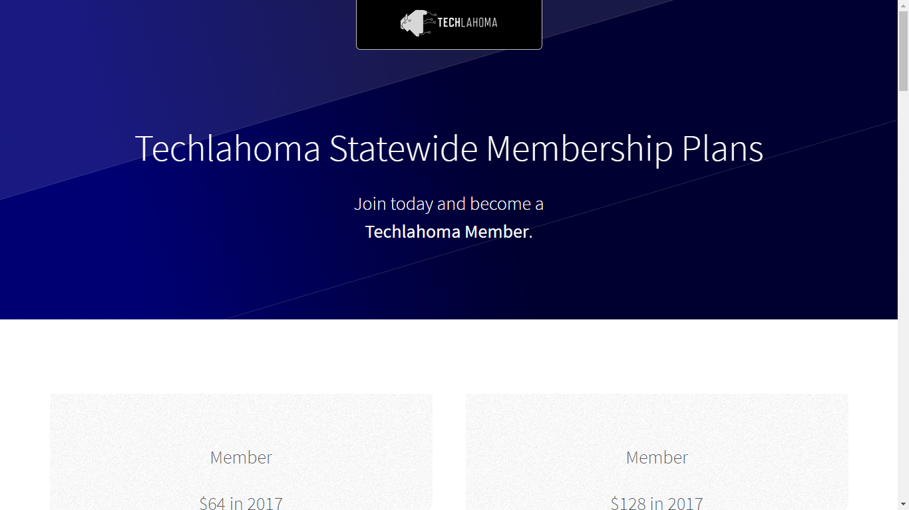
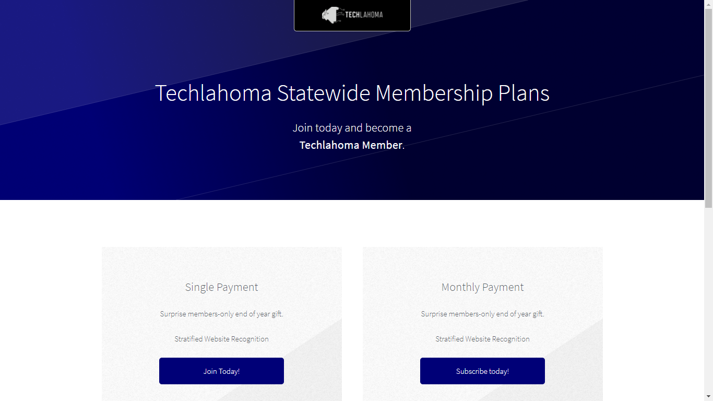

Slide 8
200OK.us
Annual conference is in Tulsa on May 18.
Call for sponsors is open.
If your company wants to advertise at 200OK and support Techlahoma, go to 200ok.us and click Sponsors to get more information.

Slide 9
StarSpace46.com
Event Center is donated by StarSpace46.
If you like them and want them to stick around, get a $40 community membership.
www.starspace46.com/calendar-1

Slide 10
Twitch.tv/Techlahoma
Live streaming at StarSpace46
Subscribe with Amazon Prime
Techlahoma gets a small donation from Amazon

Slide 11
Slack
Channels for #diy-electronics, #home_automation, #jobs, #pythonista, and over 160 other topics!
www.techlahoma.org/spaces

Slide 12
Free Code Camp OKC
Sunday 2/11
2:00 - 3:00 pm
Intro to Angular Routing
www.meetup.com/freecodecampokc

Slide 13
OKC Python
Wednesday 2/14
11:30 - 12:30
Machine Learning with Scikit-Learn
www.meetup.com/okcpython

Slide 14
DevOps OKC
Friday 2/16
11:30 - 12:30
SaltStack with Floyd May
www.meetup.com/devopsokc

Slide 15
OKC SQL
Monday 2/19
6:00 - 8:00 pm
Public Speaking: How to overcome your fears and choose the right topic
www.meetup.com/okcsql

Slide 16
Techlahoma Hack Night
Tuesday 3/6
6:00 - 8:00 pm
Bring Your Own Project
www.meetup.com/techlahoma-foundation

Slide 17
Today’s Lightning Talks
Kimberly Collins - Physical Computing with Scratch
Lawrence Kincheloe - SpaceX Launch
Adam Collins - OpenHAB

